Slide 1
Welcome to Marketing Operations Open Office Hours – June Session

Slide 2
Agenda
ON24 MQL form update – Presented by Phil Cuff
External activity uploads – Presented by Abhijith Joseph
Guide to SEO services – Presented by Brandon Haslip

Slide 3

Marketing Operations Open Office Hours
Get your questions answered by the marketing operations team. Open Office Hours are held monthly with the following agenda:
Learn about a tip or best practice
Ask a question – Pre-submit your questions here or ask during the office hours
Learn how to leverage IQVIA’s marketing systems and processes most effectively
Action: Sign up here, if you need to be added to the outlook invite
Reminder: Save your questions for the end or enter in the chat. We will address as many as we can!

Slide 4
New MQL Registration Field – Presented by Phil Cuff

Slide 5
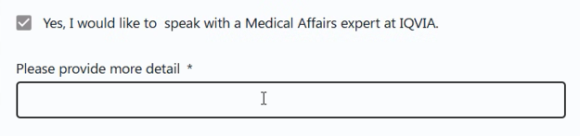
Enhance MQL quality from ON24 webinar registrations
To further improve the quality and conversion of the MQL checkbox, we’ve introduced an enhancement to prompt for additional details.
The open text field allows you to collect more details on the business needs for appropriate sales follow up.
We also anticipate that the field will reduce inaccurate selections, ensuring stronger lead validation.

Slide 6
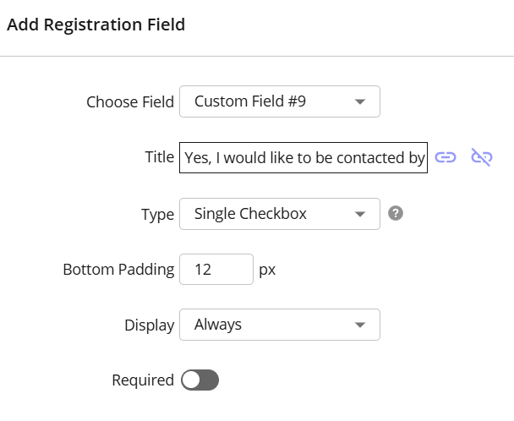
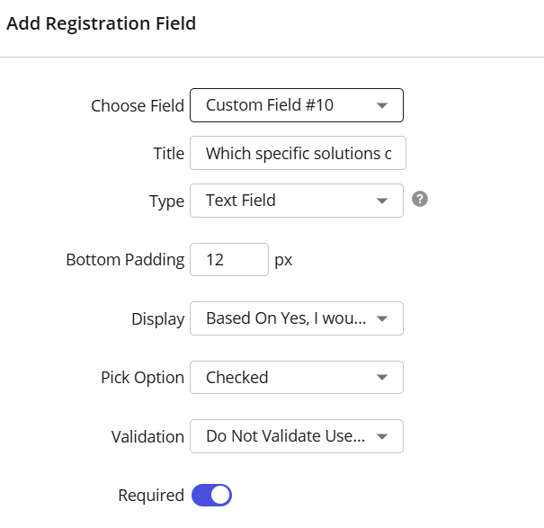
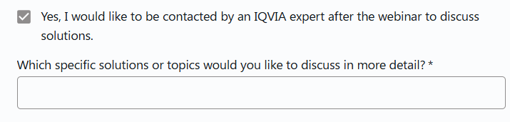
Process for the Registration Follow-Up Field
Correct custom fields need to be used to ensure mapping to Eloqua
There are 2 custom fields on the registration form which are used for the MQL creation process, one is a checkbox field (Std9) and the other is a text field (Std10)
These fields should be applied to all webinars unless the marketer explicitly requests otherwise
Custom Field #9 (std9)
Used for the MQL checkbox
Should be set as a Single Checkbox field
Always Display and not required.
Standard wording for Custom Field #9 should be along the lines of - Yes, I would like to be contacted by an IQVIA expert after the webinar to discuss solutions.
Custom Field #10 (std10)
Used for the free text field
Set as Text Field
Display based on the Custom Field #9 question
Pick Option should be Checked,
Validation should be set to ‘Do Not Validate’
Set as Required
Standard wording for Custom Field #10 should be Which specific solutions or topics would you like to discuss in more detail?

Slide 7
External activity uploads – Presented by Abhijith Joseph

Slide 8
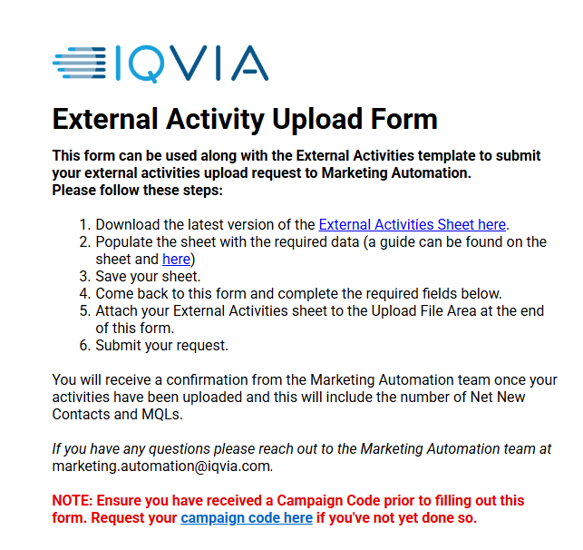
External Activity Uploads
Use the external activity uploads form when you need to submit contact information for people into Eloqua and Salesforce
These are campaign details you may collect through external activities
The first step is to download the template for the activities. You can download the form using this link or from the SmartSheet form.

Slide 9
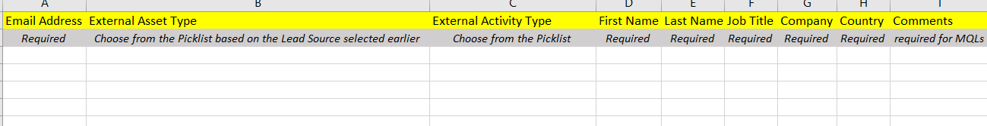
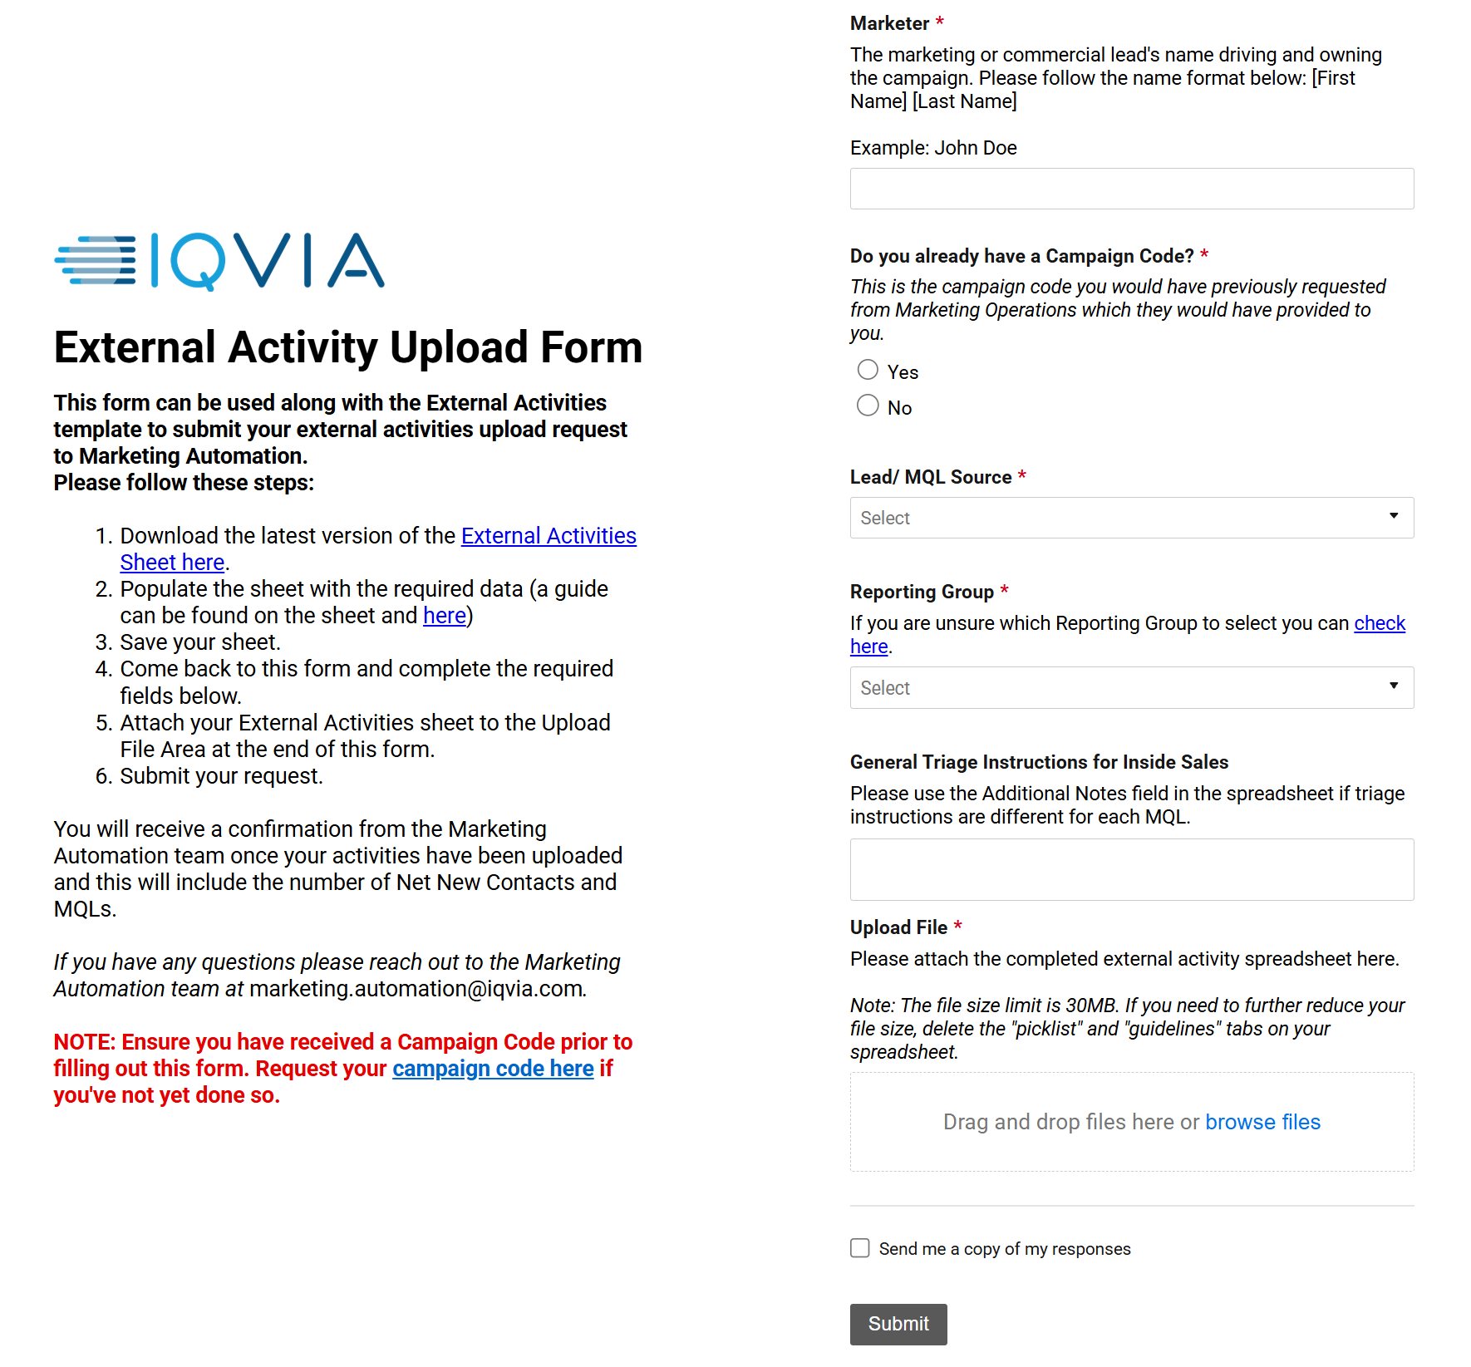

Uploading contacts to CRM: Template, Tagging + MQL Designation
External Activity template
Certain Required Fields:
External Asset Type
External Activity Type
First Name
Last Name
Job Title
Company
Country
Comments (Required for MQL)
External Asset Types
Tradeshow
Webinar
Third Party Email
Customer Event
Website
Advertising
Tagging
External Asset Types. Where did these contacts come from?
Header
Important Note on generating MQL hand raisers
The "Request Follow-up" and "Request for RFP" activities automatically generating MQLs. These are used only when THE CUSTOMER/PROSPECT explicitly requests follow up or indicates an upcoming RFP.
Options + Instructions
On the External Activity template, there are three sheets, and the guidelines provides information on how to fill the form
Notes:
Contacts received from tradeshows, webinars, third party emails, events, website or advertising are to be synched into the CRM can be uploaded through External Activity Request

Slide 10
External Asset Type & External Activity Type
External Asset Type | External Asset Activity | MQL
Tradeshow | Attended | No
 | Booth Visit | No
 | Completed Survey | No
 | Discussion | No
 | Registered | No
 | Request for Proposal | Yes
 | Requested Follow-up | Yes
 | Requested More Info | No
 | Viewed Presentation / Demo | No
External Asset Type | External Asset Activity | MQL
Webinar | Asked a Question | No
 | Attended | No
 | Completed Survey | No
 | Downloaded | No
 | Registered | No
 | Request for Proposal | Yes
 | Requested Follow-up | Yes
 | Requested More Info | No
External Asset Type | External Asset Activity | MQL
Third Party Email | Email Click | No
 | Email Delivery | No
 | Email Download | No
 | Email Open | No
 | Request for Proposal | Yes
 | Requested Follow-up | Yes
External Asset Type | External Asset Activity | MQL
Customer Event | Attended | No
 | Registered | No
 | Request for Proposal | Yes
 | Requested Follow-up | Yes
 | Requested More Info | No
External Asset Type | External Asset Activity | MQL
Website | Filled out form | No
 | Requested Follow-up | Yes
External Asset Type | External Asset Activity | MQL
Advertising | 3rd Party Website Download | No
 | Filled out form | No
 | Requested Follow-up | Yes

Slide 11
Points to remember
When submitting the external activity form
Use the correct External Activity file template
Select the correct External Asset Type and External Activity Type in the spreadsheet
Selecting the right External Asset Activity for MQLs (true hand raisers / requested to speak with an expert)
Campaign name/code are case sensitive, provide the correct campaign name
We need the campaign code for the contacts to synch into the CRM so please make sure to have the campaign name/code before submitting the form
Provide the complete information by filling out all the fields
When sharing the multiple uploads for a campaign, make sure the contacts were not uploaded in the previous list

Slide 12
Points to remember
…continued
Webinars/Events using ON24 registration – if attendees requested follow up using the checkbox on the form, MQLs will automatically be created and synched into the CRM
Consider sending 1 external activity file, rather than sending multiple files with respect to MQLs and Non-MQLs
Comments column can be used to mention the assigned person’s name and follow up details
While submitting the request, Lead/MQL source for “Customer Event” is Event IQVIA Hosted and for “Tradeshow” it is Event Industry
Provide complete country name rather than codes. For example, instead of DE, spell out Germany; instead of CH, use Switzerland

Slide 13
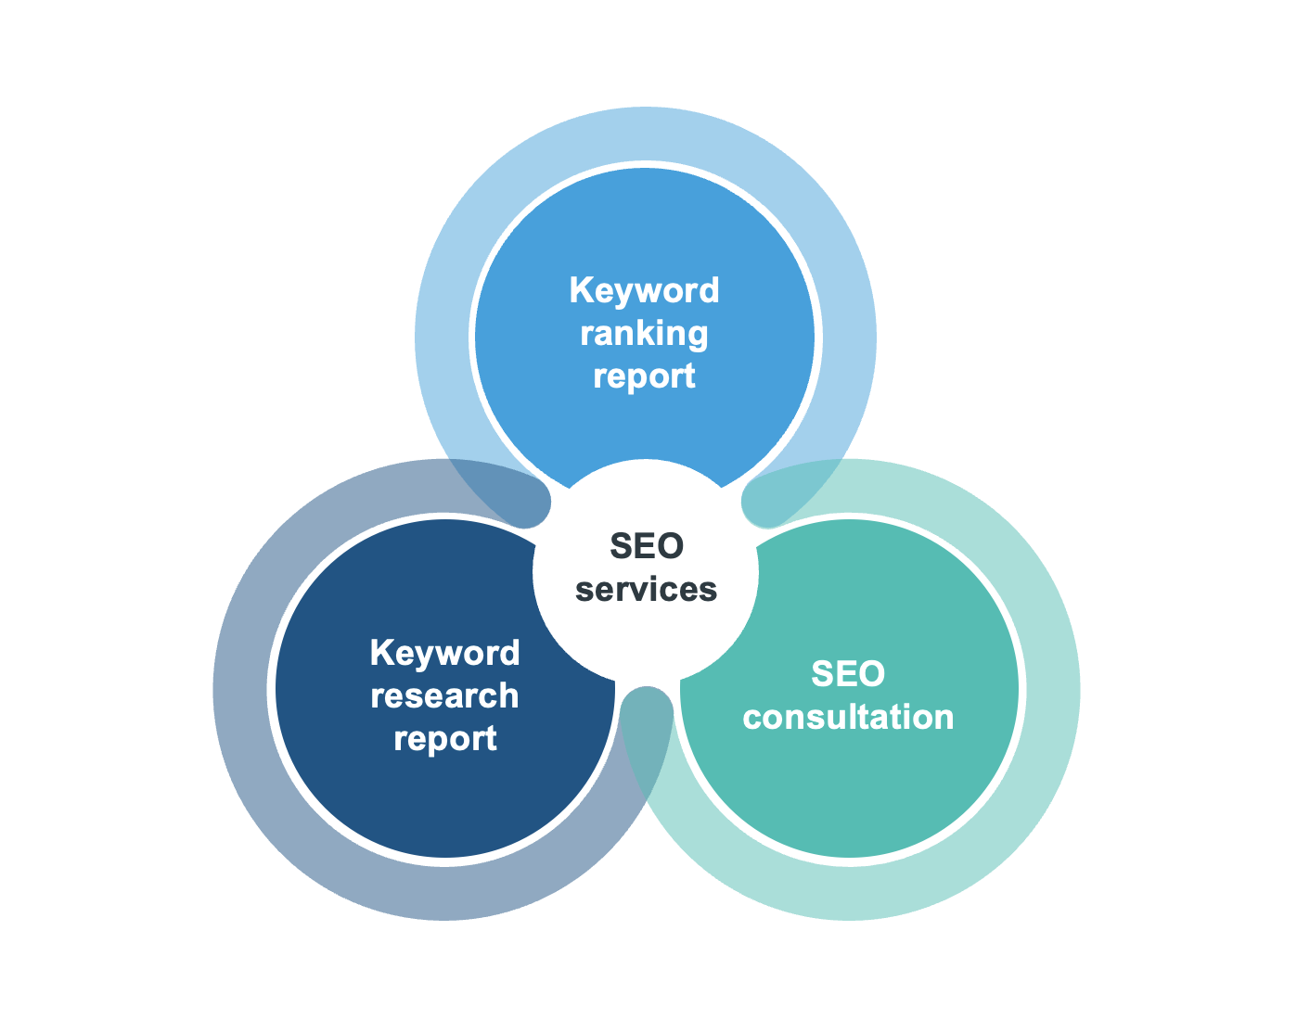
SEO at IQVIA
Introducing our new guide to SEO and the SEO services provided by Marketing Operations
Brandon Haslip, Marketing Operations
Notes:
https://brandworld.iqvia.com/media/?viewType=grid&mediaId=8364BACE-8085-460F-985BAB9B2F76F13C

Slide 14
Thank You

